Slide 1
Public Safety Technology
Automated License Plate Readers and Roadway Cameras
Dublin Police Department | Presented to the Chief’s Advisory Committee 10.7.2026
A detailed look at how Dublin uses technology, protects privacy
and strengthens accountability.

Slide 2
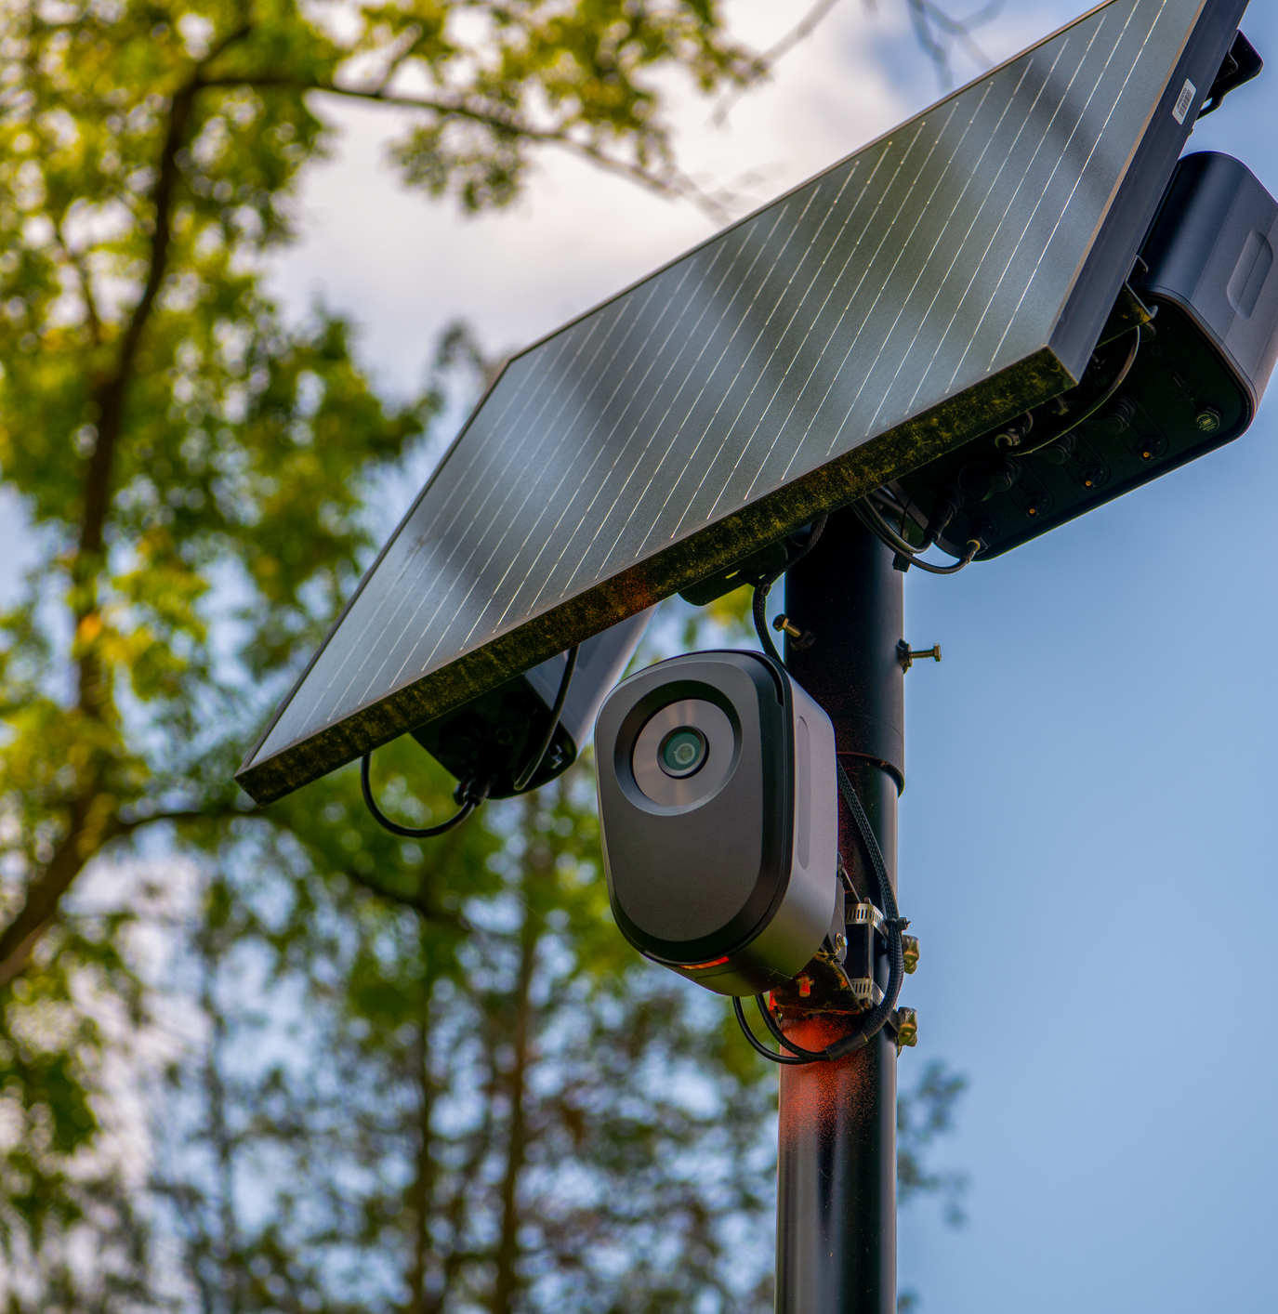

Program Overview: What We Use
Flock ALPR
Captures license plate information and limited vehicle characteristics on public roadways
Supports alerts and investigative searches
Meraki Roadway Video
Records roadway video for later review
Supports traffic and incident investigations through City partnerships
Together, these systems can clarify roadway incidents, support
criminal investigations and help locate vehicles and missing persons.

Slide 3
How It Works: Steps of ALPR
Point-in-Time Observation
License plate, vehicle image, time and camera location
Authorized Comparison
Information is compared with authorized law-enforcement data
Alert
The system provides an alert or investigative lead
Officer Verifies
An officer verifies the information before enforcement action is taken
What’s Not Detected: Personally identifying information, such as facial recognition, gender or race.

Slide 4
Program Development
A deliberate, continuously improving approach
2022
2023
2024
2024–2025
2026
Formal discussions
Officer training and policy implementation
Technology deployment
Internal audits and process improvements
Revised policy, monthly audits and audit-assistance review

Slide 5
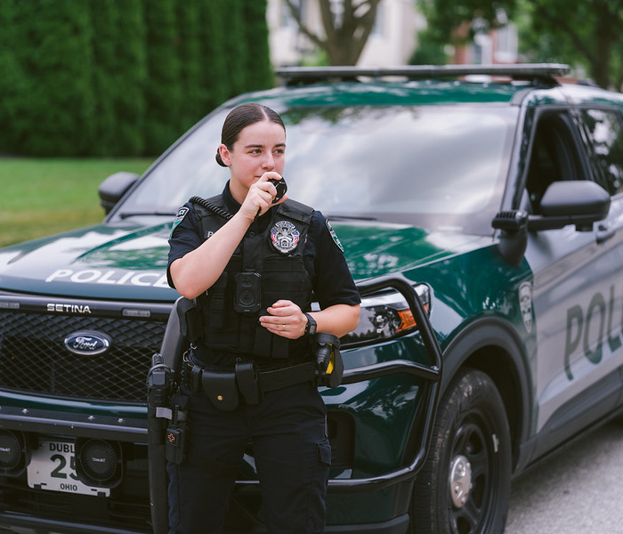

Public Safety Value
Missing Persons
Located a missing Dublin juvenile and a missing elderly adult who had left Ohio.
Crash Investigations
Developed leads in hit-skip crashes and helped officers recover stolen vehicles.
Major Investigations
Identified a robbery suspect’s vehicle and assisted in a fatal overdose investigation.
Dublin Police recently shared these and other investigative successes at a Flock conference.

Slide 6
Privacy and Accountability

Slide 7
Policy Safeguards
Trained Access
Only trained personnel may use the system
Official Purpose
Limited to criminal justice and official law-enforcement purposes
Secure Devices
CJIS-compliant devices only; follows LEADS, NCIC and CJIS rules
Search Documentation
Offense type plus a case or call-for-service number required
Limited Retention
Flock data is automatically deleted after 30 days
Verification required: alerts must be independently confirmed before any enforcement.
LEADS, NCIC and CJIS are the state and federal criminal justice data systems and security standards that govern this access.

Slide 8
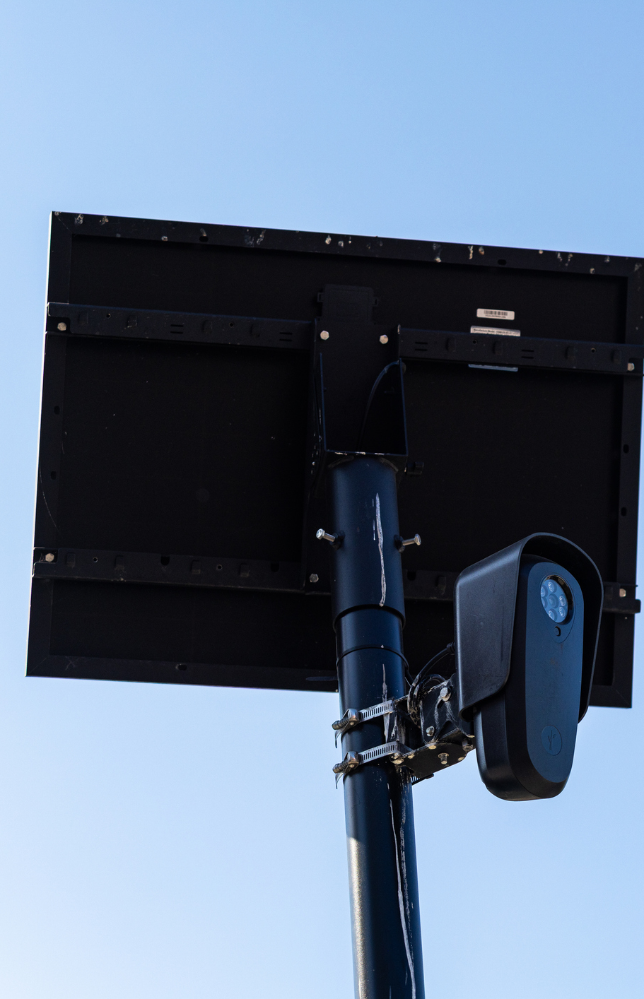
Audit and Review: Oversight Is Built In
Monthly
Administrative review of search activity
Quarterly
Policy-required audit of the organizational search log
Annually
Documented review of audits and outcomes
Ongoing
Leadership inspection, with correction and retraining when needed
Findings drive correction and retraining, not just documentation.

Slide 9
Audit Findings: Identified and Corrected
What the Audits Found
Some users entered descriptive text rather than a required case or call-for-service number.
Corrective Action
Agency-approved offense types, policy review, retraining and random audit verification strengthened compliance.
These were policy-entry findings, not findings of improper use.

Slide 10
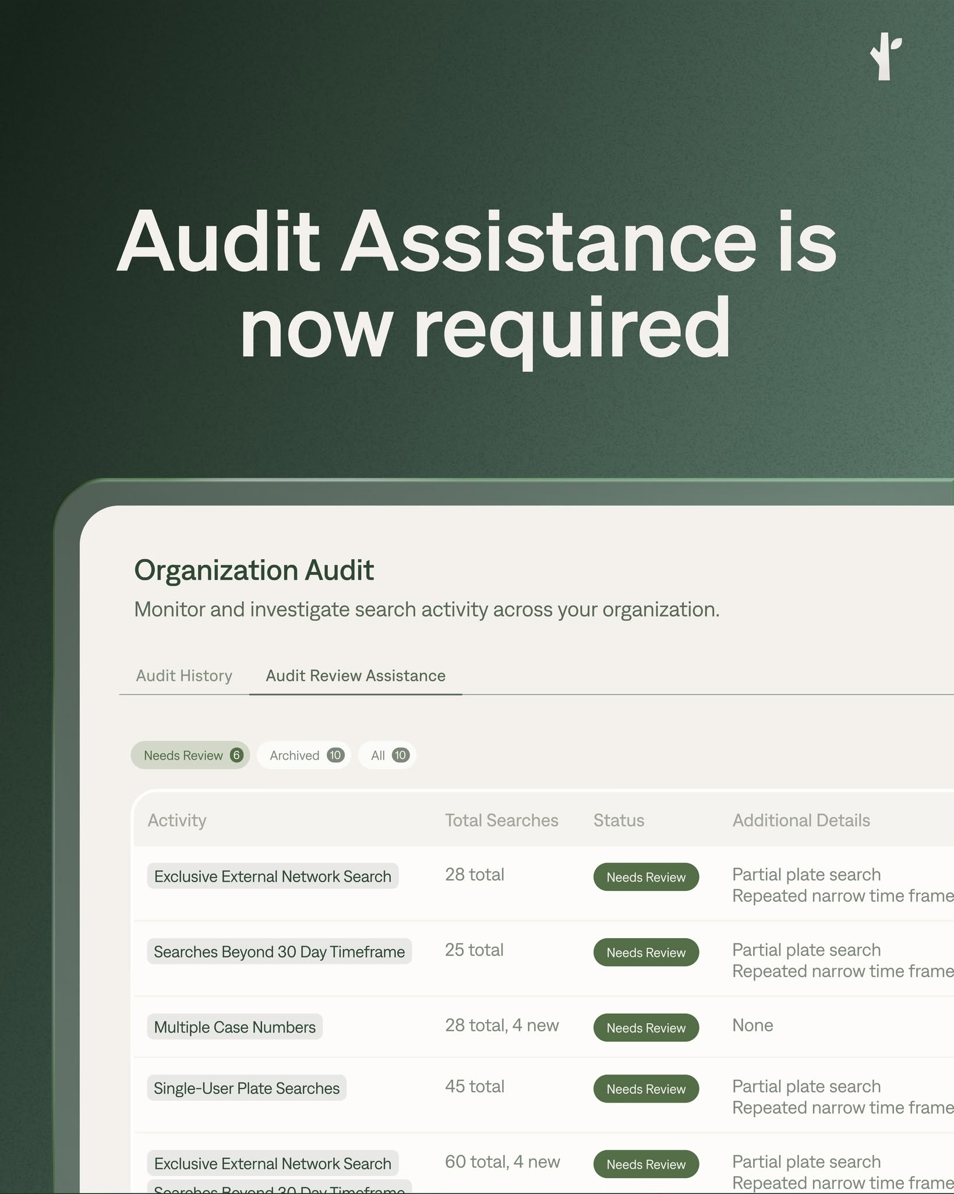
Enhanced Oversight
The Flock Audit Assistance tool adds another layer of review
Review Indicators
Searching for the same plate for extended periods (>30 days)
One plate searched under multiple case numbers
Repeated searches of the same plate by one user
External-network-only searches
Related searches in a narrow timeframe
Important Context
These indicators do not establish misconduct. They identify activity that warrants additional supervisory review.

Slide 11
Documented Accountability
24 Searches flagged for review
24 Legitimate purposes confirmed
Individually Reviewed
Each instance was reviewed using incident reports, call-for-service information and case context.
Review Result
All 24 searches were confirmed as having legitimate law-enforcement purposes.
No misuse or misconduct was identified.
Reflects all searches flagged for review since program implementation.

Slide 12
Data Sharing

Slide 13

Data Sharing and Immigration-Related Searches
Dublin controls its settings
Immigration Enforcement
Immigration enforcement is not an available search purpose.
Dublin has no reciprocal agreement with DHS or ICE.
Settings remain under City control.
Regional Accountability Model
The City's legal team, Frost, Brown, Todd and Gibbons drafted an interagency agreement that would require outside agencies to acknowledge specific conditions before access is granted.

Slide 14
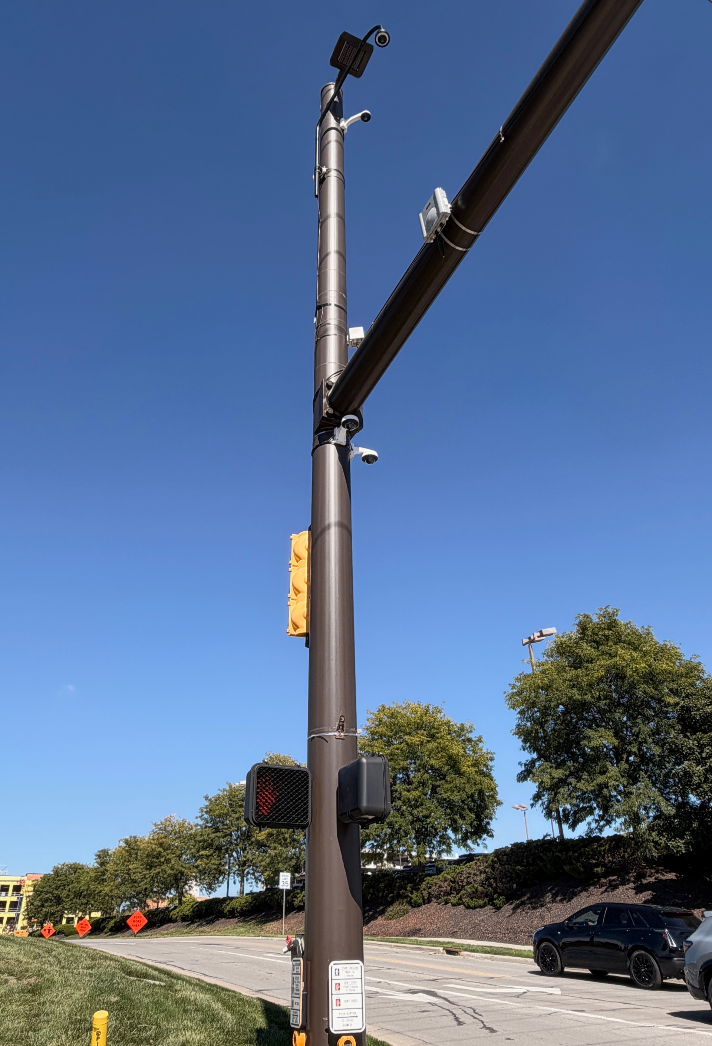
Transparency and Community Access
Information about the program is publicly available
Publicly Available Resources
Dublin Public Safety Technology webpage
Automated License Plate Reader Policy
Flock Transparency Portal
Public safety updates and community presentations
Our Commitment
Use technology for legitimate public-safety needs.
Protect privacy through policy and access controls.
Audit use, correct issues and retrain when needed.
Share clear information with the community.

Slide 15
Dublin’s Camera Deployment
Deployment principles guide where cameras are placed
29
5
Permanently installed Flock cameras
Portable “flex” cameras for temporary deployment
Camera locations and program information are communicated through the City’s
public-safety technology resources.

Slide 16
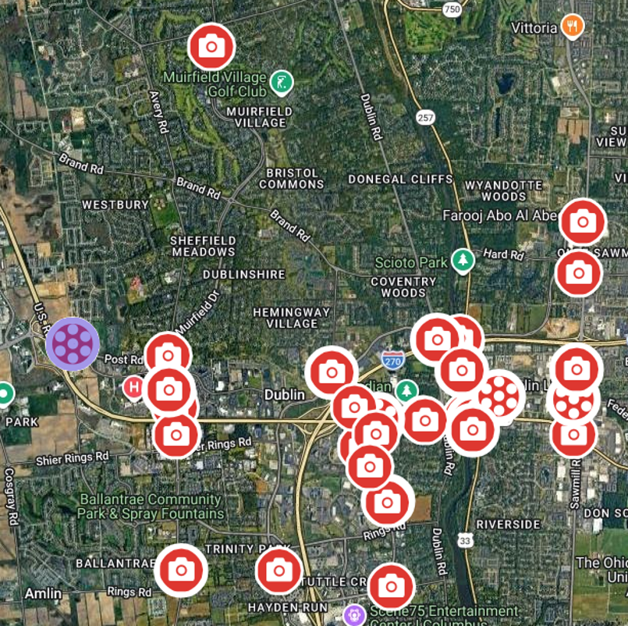
Dublin’s ALPR Camera Network

Slide 17
Questions and Community Discussion

