Slide 1
WELCOME Franklin Street Improvements Public Meeting
DIVISION OF ENGINEERING
April 20, 2022
We will begin the presentation shortly.
You will be notified when the meeting starts.
Notes:
Welcome. Thank you for attending.
Introductions to City Staff

Slide 2
Franklin Street Improvements Public Meeting
DIVISION OF ENGINEERING
April 20, 2022
Notes:
Welcome. Thank you for attending.
Introductions to City Staff

Slide 3
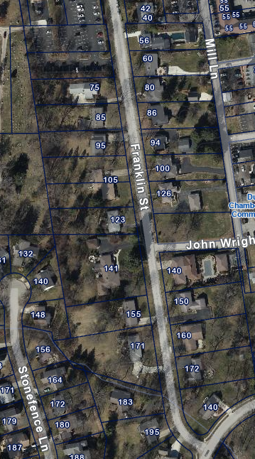
FRANKLIN STREET IMPROVEMENTS
Agenda
Project updates
Utility burial updates
Project timelines
Neighborhood feedback
Notes:
The topics we will be covering include those listed on the screen:

Slide 4
PROJECT UPDATES

Slide 5
PROJECT OVERVIEW
Reconstruction of Franklin Street from Sells Alley to Waterford Drive
Improvements include:
Reconstruction of the roadway
Sidewalk & ADA Ramps
Street trees
Utility burial in related project prior to street improvement project
Project Rationale
Address utility burial impacts
Pedestrian enhancement requests
Franklin Street scheduled for roadway maintenance

Slide 6
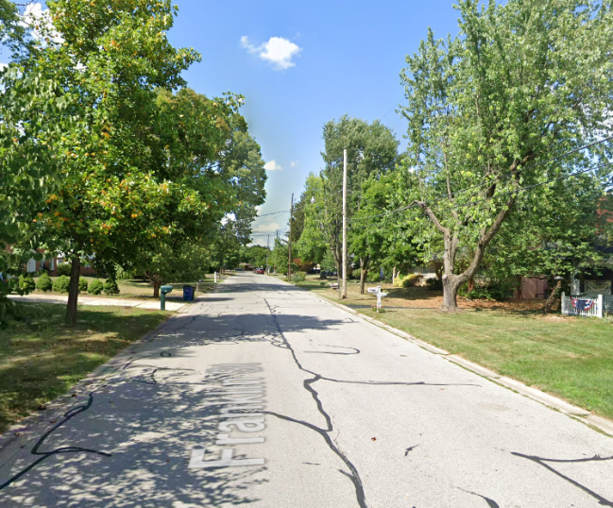
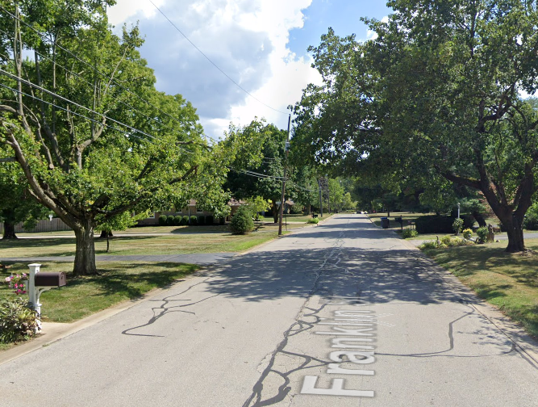
CURRENT ROADWAY

Slide 7
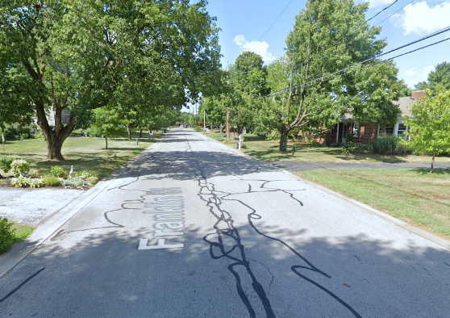
CURRENT ROADWAY
Current Roadway:
20-28 foot wide paved roadway
No pedestrian facilities
On-street parking on both sides
AEP-owned and maintained street lights at various locations
Street trees at various locations

Slide 8
SURVEY RESULTS (DECEMBER 2021)
1. Sidewalks (20):
50% for sidewalks,
40% against,
10% no preference
2. Sidewalk location (10):
80% for both
3. On-street parking (20):
40% for both,
30% for one side,
15% for no parking,
15% no preference
4. Burial of overhead utility lines (20):
80% for burial
Notes:
COUNCIL PRESENTATION ON FEB 14, 2022 MTG.
Couple residents expressed their desire for brick sidewalks and narrower street widths
Council requested staff to ask residents for additional feedback on these design features

Slide 9
PROJECT MODIFICATIONS FROM RESIDENT FEEDBACK
Transformer location
transformers moved to rear of property where feasible
Roadway width reduction
Current designs propose further roadway reduction
Vehicle speeds
Roadway designs proposed promote a self-enforcing roadway for vehicle speeds
Sidewalk locations, widths, and materials
Sidewalk designs adjusted based on resident feedback
Tree lawn widths
adjusted to fit roadway and sidewalk widths while allowing for additional street trees
Parking locations
adjusted dependent upon roadway width feedback

Slide 10
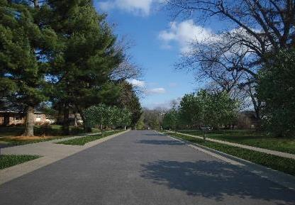
PROPOSED ROADWAY OPTIONS – DESIGN
Roadway Design #1 -
22 foot wide Sells to John Wright
On-street parking on the both sides
20 foot wide John Wright to Waterford
On-street parking on the east side
Roadway Design #2 -
20 foot wide Sells to Waterford
On-street parking on the east side
Concrete curb & gutter
Pedestrian walkway on both sides
5 foot wide
Brick or concrete material options.
Additional street trees at regular intervals

Slide 11
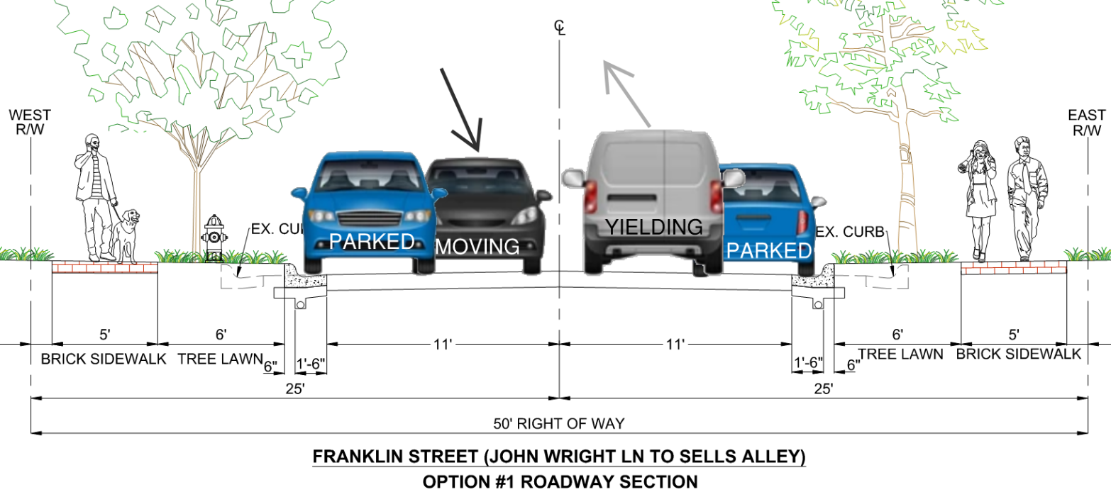
PROJECT OVERVIEW – DESIGN #1

Slide 12
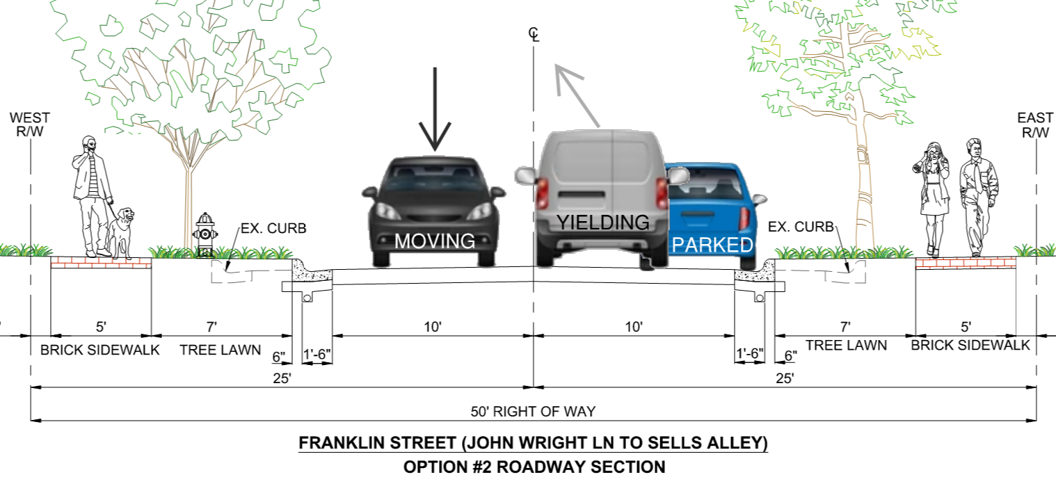
PROJECT OVERVIEW – DESIGN #2

Slide 13
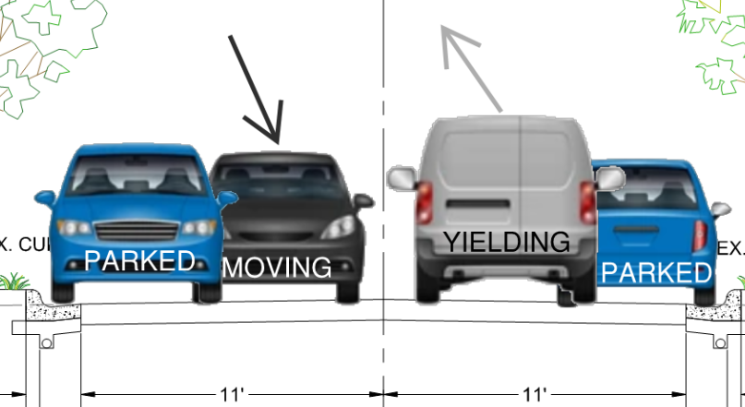
PARKING EFFECTS – DESIGN #1
Roadway movements Design #1:
Yield condition for opposing traffic
Both vehicles meander around parked vehicles
Best option for speed control with parking
Roadway layout requires a 22 foot roadway width minimum

Slide 14
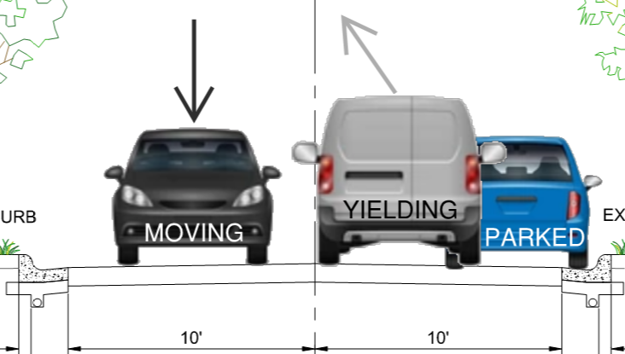
PARKING EFFECTS – DESIGN #2
Roadway movements Design #2:
Yield condition for opposing traffic
Only northbound vehicles meander around parked vehicles.
Southbound vehicles are free-flowing
Will help control speeds with parking
20 foot roadway width minimum for emergency vehicles

Slide 15
UTILITY BURIAL UPDATES

Slide 16
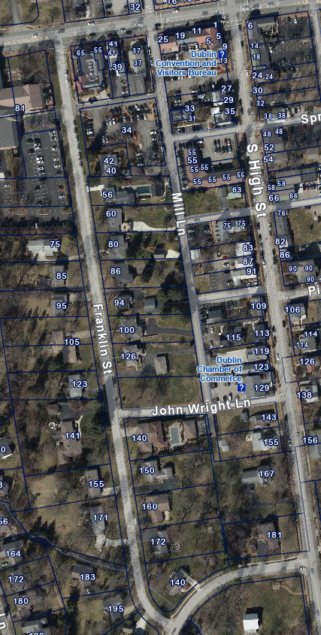
UTILITY BURIAL OVERVIEW
Relocate overhead utilities, both power and telecommunications to underground from Franklin Street to South High Street and from West Bridge Street to Waterford Drive
AEP distribution primary to be relocated from South High Street to Franklin Street (underground)

Slide 17
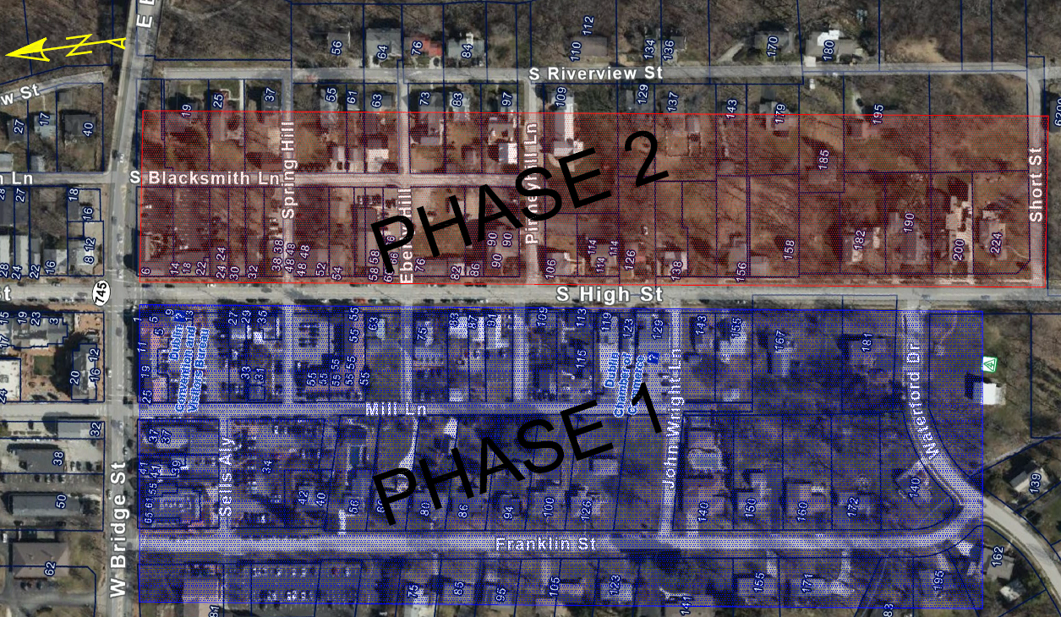
UTILITY BURIAL OVERVIEW

Slide 18
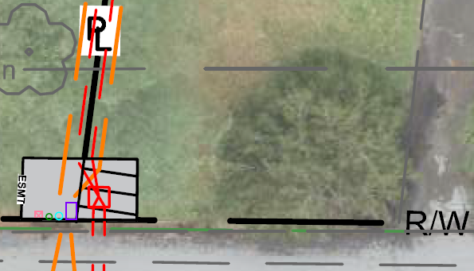
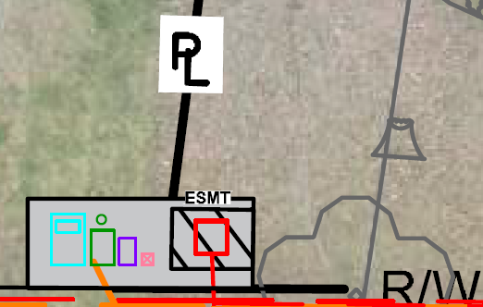
UTILITY BURIAL OVERVIEW – EASEMENT EXAMPLES
Easement Area Plan
Rear lot from Mill lane
Easement Area Plan
Front Lot on Franklin Street

Slide 19
UTILITY BURIAL - EASEMENTS
Easement sizes have been reduced as much as possible.
Transformers & pedestals have been moved to the rear of each lot where possible
Screening will be performed around above ground utility features.
Easement exhibits for each property will be available to the property owner after the presentation.

Slide 20
PROJECT TIMELINES

Slide 21
ESTIMATED PROJECT TIMELINES
Utility Burial Project (Phase 1)
On-going – Design on-going for Electrical & Communications
Began April 2022 – Acquisition of easements
October 2022 – Complete acquisition of easements
October 2022 – Begin Electrical & Communications burial work
June 2023 – Complete Electrical & Communications burial work
Franklin Street Improvements Project
Today – Design on-going
March 2023 – Begin construction
November 2023 – Complete construction

Slide 22
NEIGHBORHOOD FEEDBACK

Slide 23
WE WANT YOUR FEEDBACK!
Resident survey regarding design elements
Responses on comment cards
One survey response is allowed per household. All comments are welcome.
Survey’s will be hand delivered to each address tomorrow.
Replies must be postmarked on or before May 16, 2022.

Slide 24
WHAT’S NEXT?
May 16, 2022 - Comments & comment cards MUST be postmarked by May 16, 2022.
Comments and survey results will be reviewed
May 25, 2022 – Letter to residents
June 13, 2022 – Presentation to Council for final design decision
Watch for updated information on Dublin’s website.
DublinOhioUSA.gov/franklinstreet

Slide 25
QUESTIONS OR COMMENTS?
If you have any further questions please contact either:
Brian Gable at 614.410.4641 or bgable@dublin.oh.us
Ken Richardson at 614.410.4631 or e-mail krichardson@dublin.oh.us
For updates:
DublinOhioUSA.gov/franklinstreet
Nextdoor.com
Thank you for attending tonight’s meeting.

